Slide 1
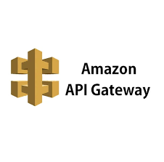
AWS API Gateway
Securely Create, Deploy, and Manage APIs

Slide 2
What is Gateway ?
Application Programming Interface
This will be help us to establish communication between two different
Applications.

Slide 3
Introduction
• Fully managed AWS service
• Create, publish, monitor, and secure APIs
• Supports REST, HTTP, and WebSocket APIs

Slide 4
Key Features
• Supports RESTful and WebSocket APIs
• Authorization & authentication
• Automatic scaling & throttling
• Caching for performance
• Integrates with AWS Lambda, EC2, S3, DynamoDB

Slide 5
Benefits of API Gateway
• No infrastructure management
• Secure API access (IAM, Cognito, API Keys)
• Pay per use
• CloudWatch monitoring
• Developer portal for publishing APIs

Slide 6
Use Cases
• Serverless web apps
• Mobile backends
• Real-time apps (WebSocket)
• Microservices management

Slide 7
Summary
• Simplifies API management
• Scalable, secure, and cost-efficient
• Ideal for serverless applications

